Slide 1
Running a T-Test in SAS
Jacob Hartt
https://youtu.be/lYg1eKKa0OY

Slide 2
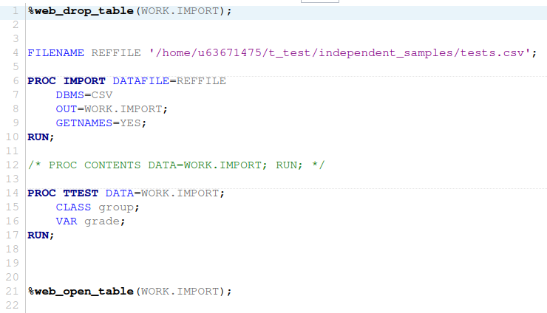
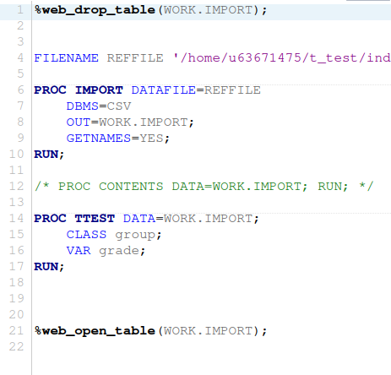
SAS Basics
Not much of a programming language, like R
Must load data files as SAS databases
Single commands provide a lot of graphs and info
Less granular than R
Less documentation and guides

Slide 3
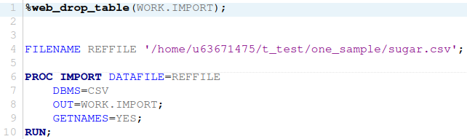
Loading Data
Macros are %snake_case
Drops table
PROC IMPORT imports data into SAS databases
Can specify input data format(DBMS)
Whether or not to use first row as column names(GETNAMES)

Slide 4
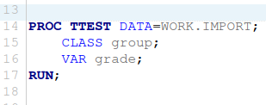
T-Test Basics
Begin with a PROC TTEST call and end with a RUN call
Dataset is selected with DATA= argument after PROC TTEST

Slide 5
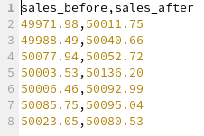
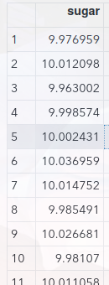
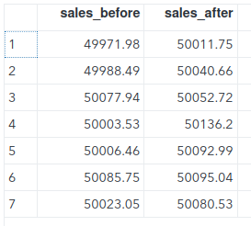
Setting Up Data For One-Sample and Paired-Samples T-Tests
Use wide table format for CSVs
All datasets are equal in length
One column for each dataset
Set column names

Slide 6
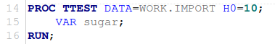
One-Sample T-Test Setup
Call PROC TTEST
Import data as usual
Set H0
Equivalent of mean/mu
Use VAR to set the column of data to analyze

Slide 7
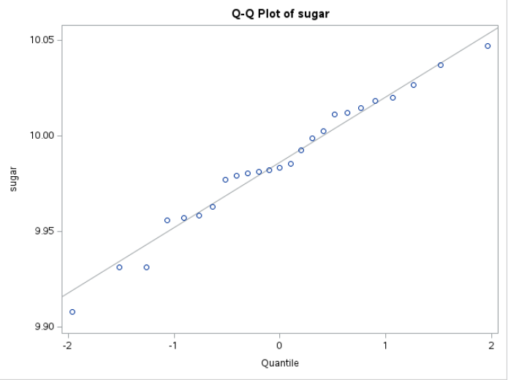
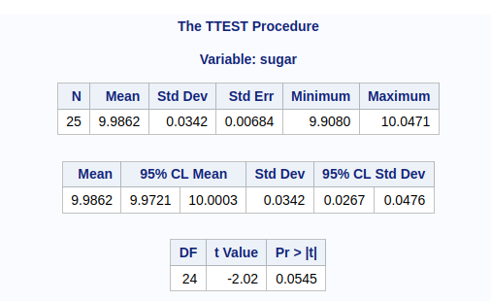
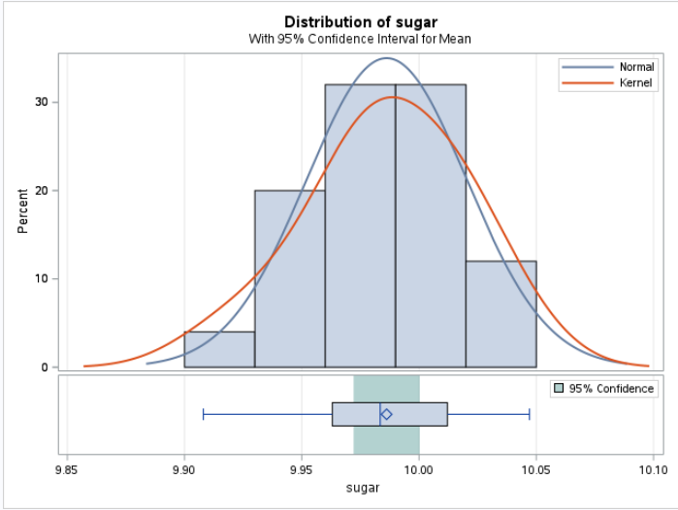
One-Sample T-Test Results
Complete overview:
Statistical data
Distribution graph
Q-Q plot

Slide 8
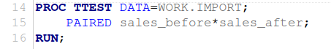
Paired-Samples T-Test Setup
Call PROC TTEST
Import data as usual
Use the PAIRED variable to set variable pairings
Use var_1*var_2 to pair the variables

Slide 9
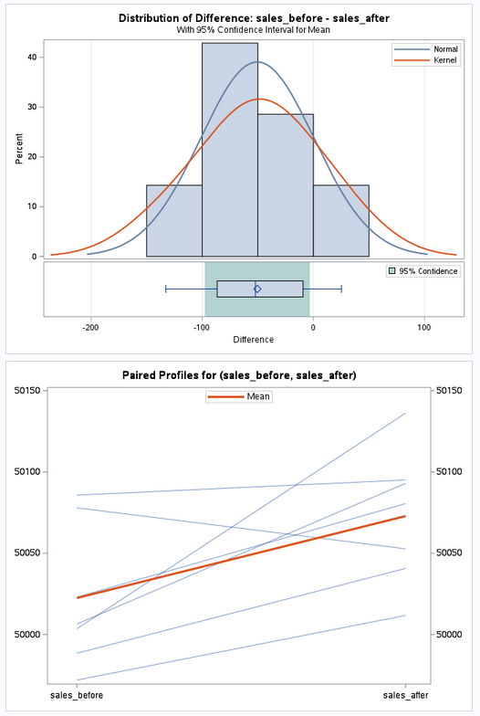
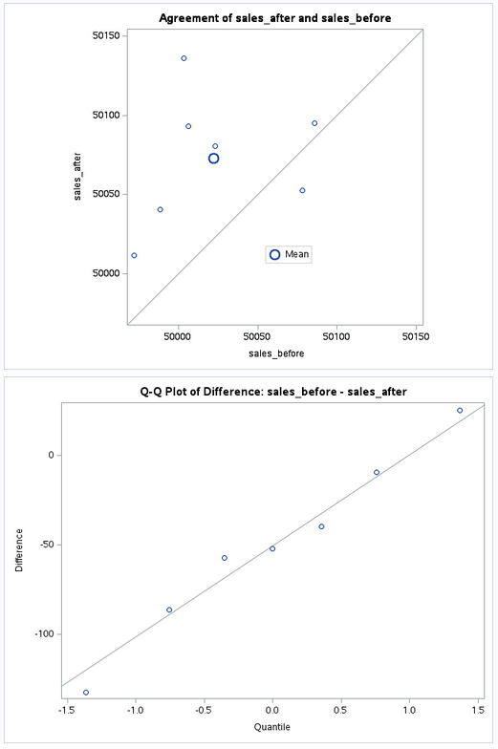
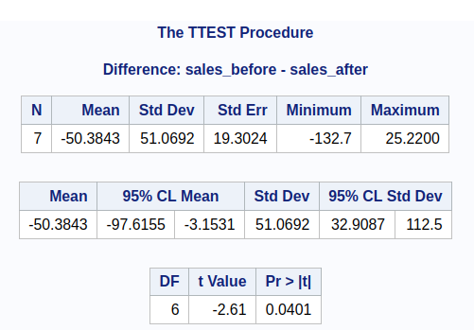
Paired-Samples T-Test Results
Statistical results
Difference distribution graph
Q-Q plot
Agreement plot
Paired profiles graph

Slide 10
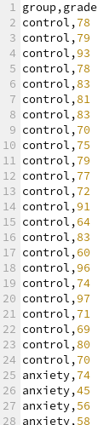
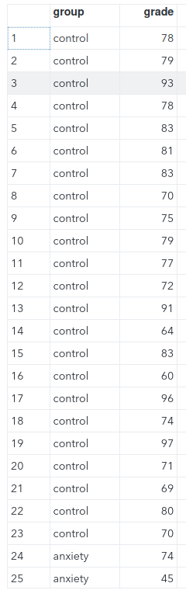
Preparing Data for Two Sample T-Test
Use long table format for csvs
Allows for groups of different sizes
Datasets can be different lengths
Dataset’s names are encoded in a group variable

Slide 11
Two Sample T-Test Setup
Call PROC TTEST
Variables are selected
Use CLASS to select the variable containing the group names
Use VAR to select the variable containing the dataset values

Slide 12
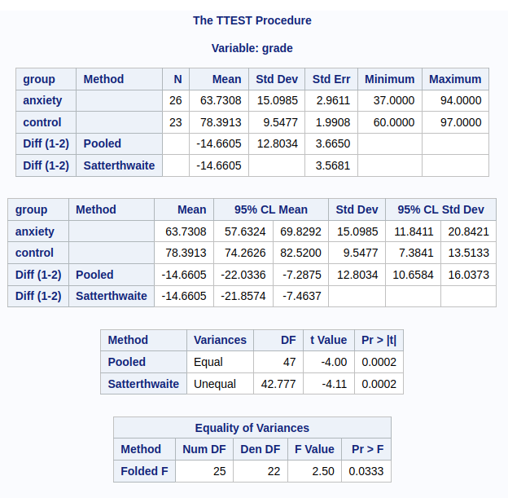
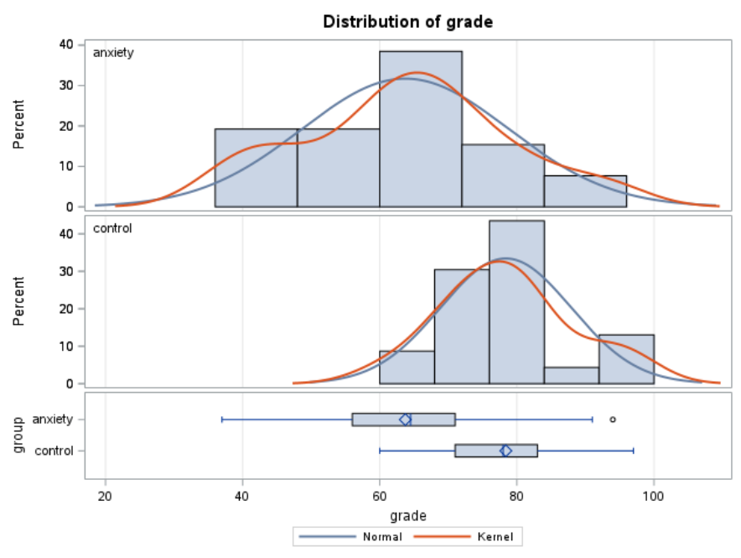
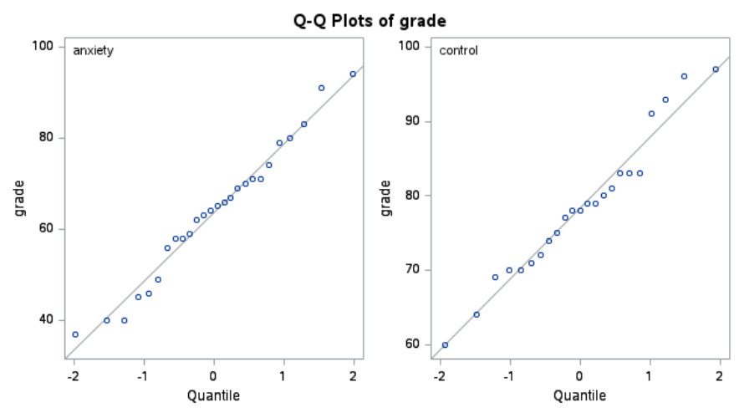
Two-Sample T-Test Results
Statistical results
Each group analyzed
Two variance methods
3 p-values
Distribution graph of both datasets
Q-Q plot of each dataset

Slide 13
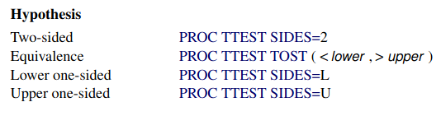
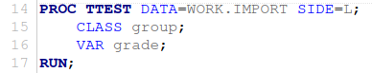
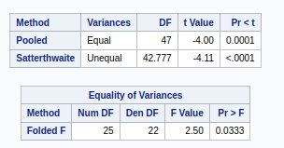
T-Test Sidedness
Use keywords to program sidedness
SIDE=
SIDED=
SIDES=
2 sidedness available

Slide 14
T-Test Grouping
Use the BY var to group results
EX: use a one-sample t-test and group using BY for analyses of each dataset

Slide 15
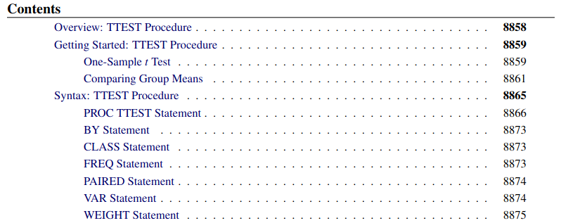
Customizing the output further
Many resources exist on SAS T-Test documentation
YouTube videos
Online guides
Official documentation
SAS/STAT User’s Guide
SAS Help Center
UCLA’s SAS resources
https://stats.oarc.ucla.edu/sas/

Slide 16
Program review

Slide 17
Thank you.

